Slide 2
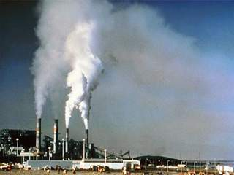
AIR POLLUTION
When any undesirable substance contaminates air, the air is said to be polluted. The substance in the air that can cause harm to living organisms and the environment is known as air pollutant.

Slide 3
GREENHOUSE EFFECT AND GLOBAL WARMING
When solar radiation falls on the earth’s surface, a part of the radiation is absorbed and a part is reflected back into space. This trapped radiation further warms the earth. The trapping of the sun’s radiation by the gases present in the earth’s is called greenhouse effect.
Global warming can be defined as the increase in average temperature of the earth’s atmosphere that cause corresponding changes in climate.

Slide 4
EFFECTS OF AIR POLLUTION
It is responsible for many respiratory diseases in humans like cough, asthma, bronchittis and sometimes even lung cancer.
Exposure to smog formed due to combination of fog and smoke causes irritation in the eyes, nose and throat.

Slide 5
PREVENTION OF AIR POLLUTION
Use carpool and public transport for long distances.
Make regular pollution checks mandatory.
Use smokeless fuels like LPG for cooking.
Plant more trees.

Slide 6
CONSERVATION OF FORESTS AND WILDLIFE
We can help conserve forests and wildlife in the following ways:
Avoid cutting trees for fuel and other purposes.
Create protected areas in places where natural habitat of wildlife has been destroyed to protect animals by providing them conditions close to their natural habitat.

